Slide 1


Juan Ramon Reyes Torres
28/07/2024

Slide 2

Outline
Executive Summary
Introduction
Methodology
Results
Conclusion
Appendix

Slide 3
Executive Summary
Summary of methodologies
In this project I use the methodologies viewed in other courses before. Just to name some of those are:
Collecting Data
Data Wrangling
EDA using SQL
EDA using pandas and Matplotlib
Interactive Visual analytics and Dashboard
Predictive analysis
Summary of all results
All the results was from the Jupiter notebooks codes, it starts from collecting Data to the predictive analysis.

Slide 4
Introduction
Project background and context
SpaceX, a leading private aerospace manufacturer and space transportation company, has revolutionized the space industry by significantly reducing the cost of launching payloads into space. One of the primary ways SpaceX has achieved this is through the reuse of the Falcon 9 rocket's first stage, which can return and land safely after launch. This project aims to develop a predictive model to forecast the success of these landings using historical launch data and relevant factors influencing the landing outcome.
Problems you want to find answers
What factors influence the success of the Falcon 9 first stage landing?
How accurate can our predictive model be in forecasting the landing success?
What is the historical success rate of Falcon 9 first stage landings?
How can this predictive model benefit competing aerospace companies?

Slide 5

Section 1

Slide 6
Methodology
Executive Summary
Data collection methodology:
The data was obtained from the official IBM and SpaceX websites, which were embedded within the code. The REQUESTS library was used to read and extract the corresponding data frame to view the data.
Perform data wrangling
The data was cleaned to ensure there were no empty cells. To achieve this, if there was any empty space, the total sum of the values was calculated, and an average was taken. Additionally, categorical values were transformed using the get_dummies function to convert them into numerical values, providing greater control over the data.

Slide 7
Methodology
Executive Summary
Perform exploratory data analysis (EDA) using visualization and SQL
For this part of the project, SQL was used to visualize the various queries needed, as well as to perform different operations to better understand the data.
Perform interactive visual analytics using Folium and Plotly Dash
In this analysis, we aim to explore the factors influencing the success rate of rocket launches, including payload mass, orbit type, and launch site location. By examining the spatial distribution and proximities of launch sites, we seek to identify optimal locations for future sites. Building on previous exploratory data analysis with matplotlib and seaborn, which revealed initial correlations between launch sites and success rates.

Slide 8
Methodology
Executive Summary
Perform predictive analysis using classification models
In this module, predictive analysis was conducted to examine how the data has interacted over time and how it might behave in the future using mathematical functions. The analysis covered four key functions:
Logistic Regression
Support Vector Machine
Decision Tree
K-Nearest Neighbors.

Slide 9
Data Collection – SpaceX API
Set Up Environment
API
Requests
Process response
Handle Errors
Save/Display Data
Run the code
https://github.com/JuanReyes2608/data-space/blob/6cb574d14fbcb841a4a12cef4bc8aec2fe9ab8dd/1.%20jupyter-labs-spacex-data-collection-api.ipynb

Slide 10
Data Collection - Scraping
Set Up Environment
Make HTTP Request
Parse HTML
Extract Data
Save/Display Data
Use pandas.get_dummies
Clean and Prepare Data
https://github.com/JuanReyes2608/data-space/blob/6cb574d14fbcb841a4a12cef4bc8aec2fe9ab8dd/2.%20jupyter-labs-webscraping.ipynb

Slide 11
Data Wrangling
The first step is to analyze the data to identify columns with missing or problematic data. After this, transform the data based on the issues found, such as converting categorical values to numerical ones or calculating averages for columns with missing values.
Set Up Environment
Inspect Data
Transform Data
Save/Display Data
Load Data
Clean Data
Integrate Data
https://github.com/JuanReyes2608/data-space/blob/6cb574d14fbcb841a4a12cef4bc8aec2fe9ab8dd/3.%20labs-jupyter-spacex-Data%20wrangling.ipynb

Slide 12
EDA with Data Visualization
Summarize what charts were plotted and why you used those charts
Flight number and Launch Site
To see the total of flights by each launch site.
Payload mass and Launch Site
To see the payload mass used by each site.
Success rate and orbit type
To view the success rate of each orbit type.
Flight number and orbit type
To see the total of flights by each orbit type.
Payload Mass and Orbit type
To see the payload mass used by each site.
Success Rate by year
To view the success rate of each year.
https://github.com/JuanReyes2608/data-space/blob/6cb574d14fbcb841a4a12cef4bc8aec2fe9ab8dd/5.%20jupyter-labs-eda-dataviz.ipynb

Slide 13
EDA with SQL
Using bullet point format, summarize the SQL queries you performed
Display the names of the unique launch sites in the space mission
Display 5 records where launch sites begin with the string 'CCA'
Display the total payload mass carried by boosters launched by NASA (CRS)
Display average payload mass carried by booster version F9 v1.1
List the date when the first successful landing outcome in ground pad was achieved.
List the names of the boosters which have success in drone ship and have payload mass greater than 4000 but less than 6000
List the total number of successful and failure mission outcomes
List the names of the booster_versions which have carried the maximum payload mass. Use a subquery
List the records which will display the month names, failure landing_outcomes in drone ship ,booster versions, launch_site for the months in year 2015.
Rank the count of landing outcomes (such as Failure (drone ship) or Success (ground pad)) between the date 2010-06-04 and 2017-03-20, in descending order.
https://github.com/JuanReyes2608/data-space/blob/6cb574d14fbcb841a4a12cef4bc8aec2fe9ab8dd/4.%20jupyter-labs-eda-sql-coursera_sqllite.ipynb

Slide 14
Build an Interactive Map with Folium
We used Folium and Pandas to create an interactive map with SpaceX launch data. The map, centered on NASA Johnson Space Center, features markers for launch sites color-coded by success. We added a MousePosition plugin for coordinate tracking and drew PolyLines to measure distances to nearby features like cities and coastlines.
We added markers to visualize launch sites and color-coded them to differentiate between successful and failed launches, aiding in data analysis. The MousePosition plugin was included to track and display coordinates on the map, helping to pinpoint specific locations accurately. PolyLines were drawn to measure and analyze distances between launch sites and nearby features like cities and coastlines, facilitating proximity analysis.
https://github.com/JuanReyes2608/data-space/blob/6cb574d14fbcb841a4a12cef4bc8aec2fe9ab8dd/6.%20lab_jupyter_launch_site_location.ipynb

Slide 15
Build a Dashboard with Plotly Dash
This Dash application visualizes SpaceX launch records with several interactive components:
Dropdown Menu (Task 1):
A dropdown menu allows users to select a specific launch site or view data for all sites.
Pie Chart (Task 2):
A pie chart displays the total number of successful launches for the selected launch site. If "All Sites" is selected, it shows the success count for each site.
Range Slider (Task 3):
A range slider enables users to filter the data based on payload mass (in kg). Users can select a payload range to visualize in the scatter plot.
Scatter Plot (Task 4):
A scatter plot illustrates the correlation between payload mass and launch success. The points are color-coded based on the booster version category. The plot updates based on the selected launch site and payload range.
These components allow users to interactively explore how payload and launch success vary across different launch sites and booster versions.
https://github.com/JuanReyes2608/data-space/blob/fbe2ec9d316af97d7a283c110849c8c239454116/7.%20spacex_dash_app.py

Slide 16
Predictive Analysis (Classification)
The best classification model was created by standardizing the data, splitting it into training and testing sets, and tuning various models (Logistic Regression, SVM, Decision Tree, k-NN) using GridSearchCV. The SVM model achieved the highest accuracy on the test set, making it the best performing model.
Set Up Environment
Load Data
Clean Data
Select Model
Split Data
Feature Engineering
Train Model
Evaluate Model
Make Predictions
https://github.com/JuanReyes2608/data-space/blob/fbe2ec9d316af97d7a283c110849c8c239454116/8.%20SpaceX_Machine_Learning_Prediction_Part_5.jupyterlite.ipynb

Slide 17
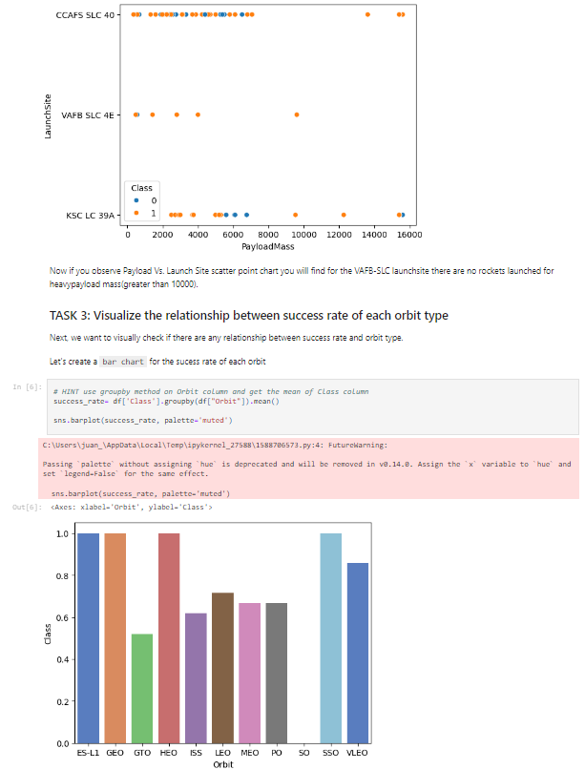
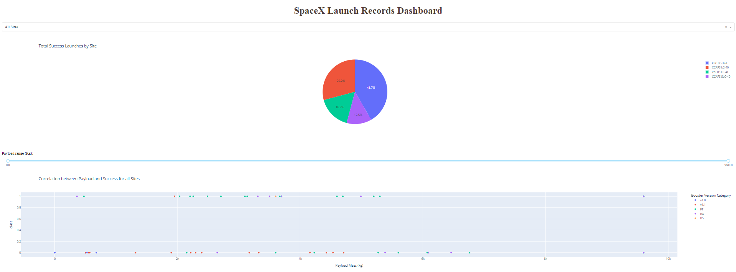
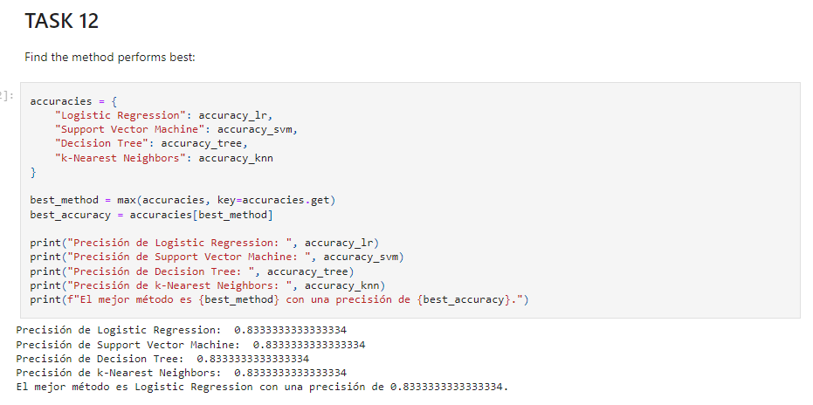
Results
Exploratory data analysis results
Interactive analytics demo
Predictive analysis results

Slide 18

Section 2

Slide 19
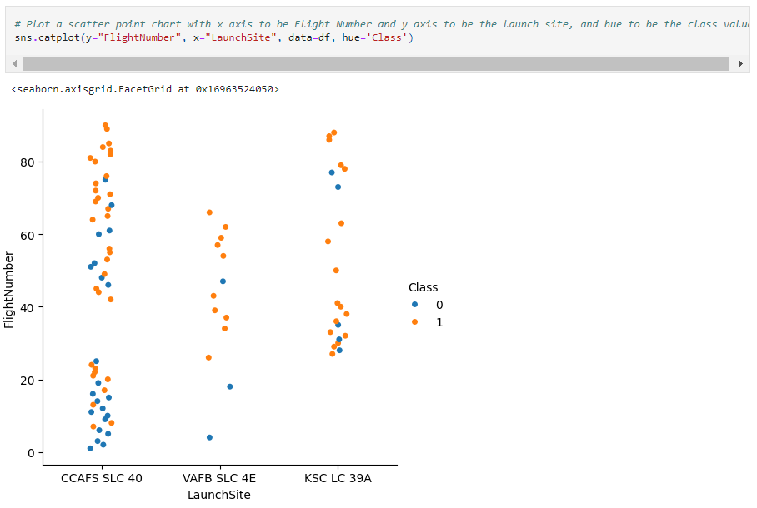
Flight Number vs. Launch Site
In the scatter plot, it can be seen that the CAFS SLC 40 site has a higher number of flights compared to the other sites.

Slide 20
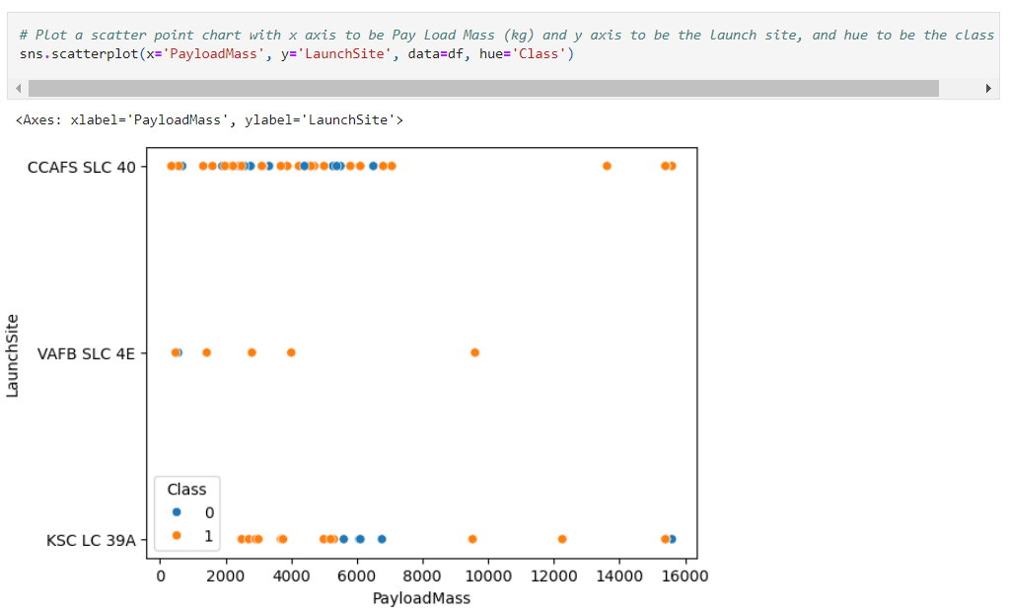
Payload vs. Launch Site
In this graph, it can be observed that there are more payload mass values that are less than 8000.

Slide 21
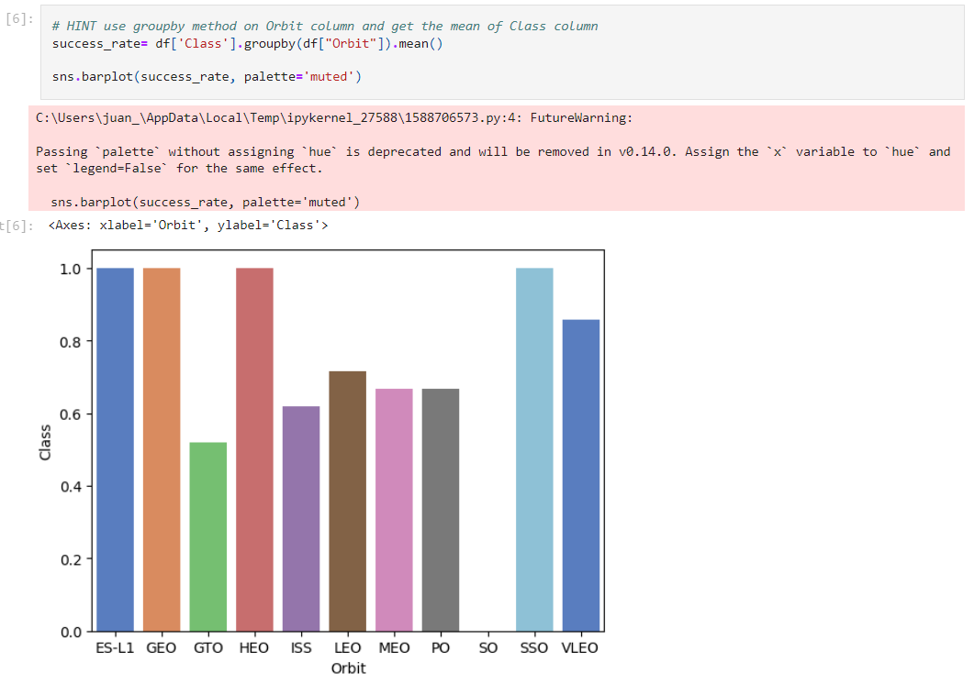
Success Rate vs. Orbit Type
The orbits with the highest success rate are ES-L1, GEO, HEO, and SSO.

Slide 22
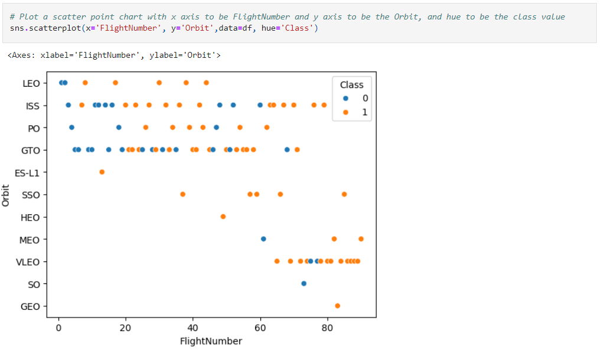
Flight Number vs. Orbit Type
The orbit with the highest number of flights is VLEO.

Slide 23
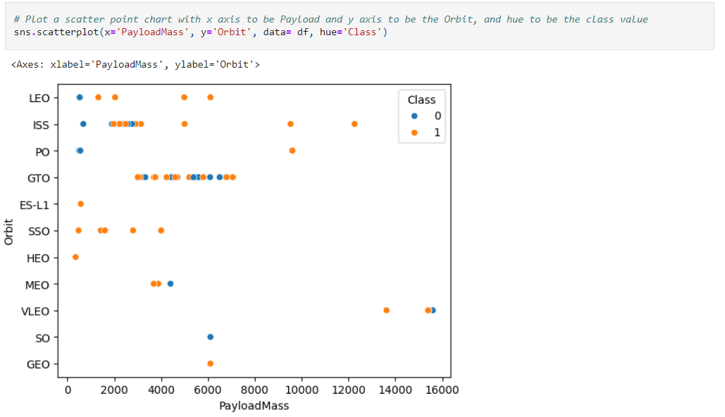
Payload vs. Orbit Type
The orbit with the highest payload mass is VLEO, with over 14,000.

Slide 24
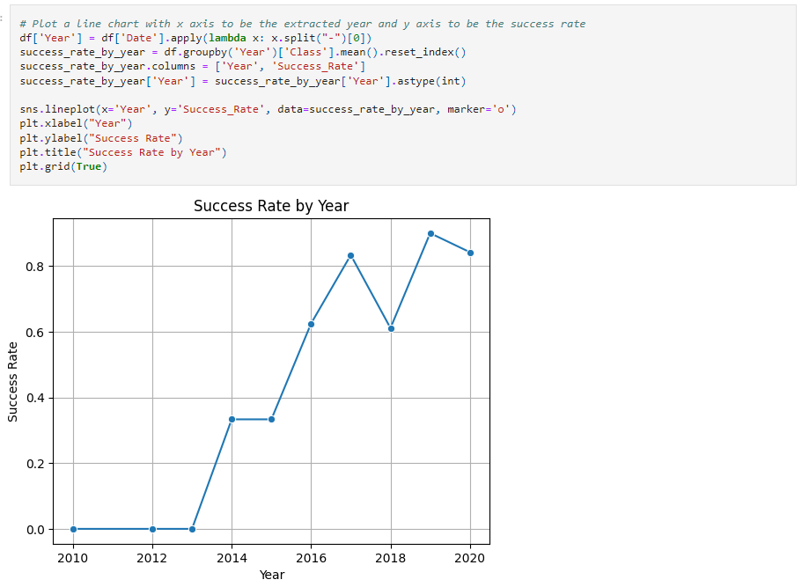
Launch Success Yearly Trend
The success rate can be observed for each year, with higher success rates in certain years.

Slide 25
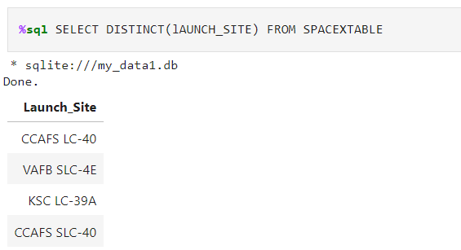
All Launch Site Names
Find the names of the unique launch sites

Slide 26
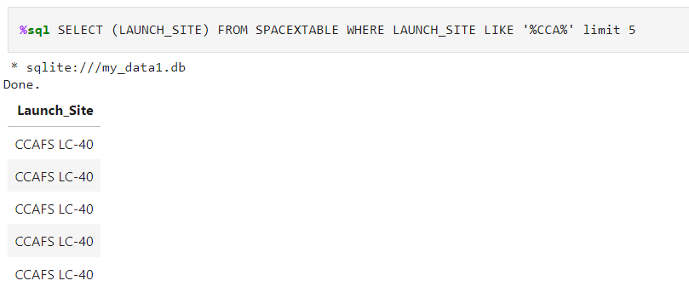
Launch Site Names Begin with 'CCA'
Find 5 records where launch sites begin with `CCA`

Slide 27
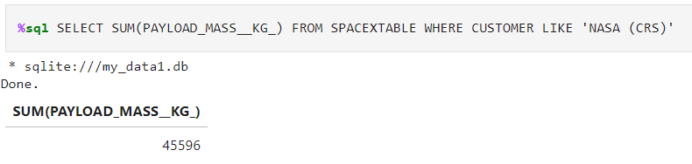
Total Payload Mass
Calculate the total payload carried by boosters from NASA

Slide 28
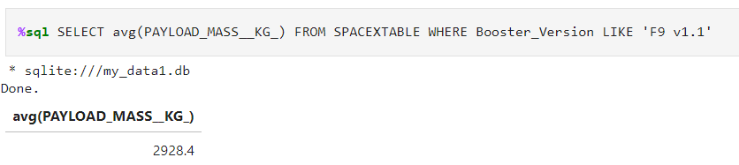
Average Payload Mass by F9 v1.1
Calculate the average payload mass carried by booster version F9 v1.1

Slide 29
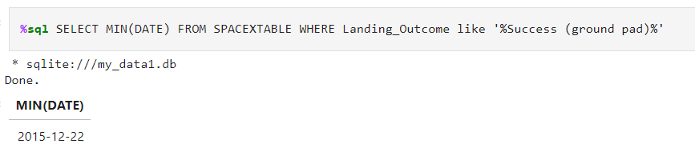
First Successful Ground Landing Date
Find the dates of the first successful landing outcome on ground pad

Slide 30
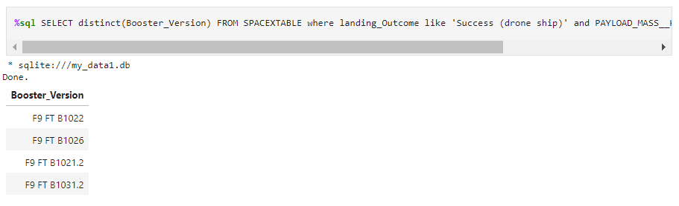
Successful Drone Ship Landing with Payload between 4000 and 6000
List the names of boosters which have successfully landed on drone ship and had payload mass greater than 4000 but less than 6000

Slide 31
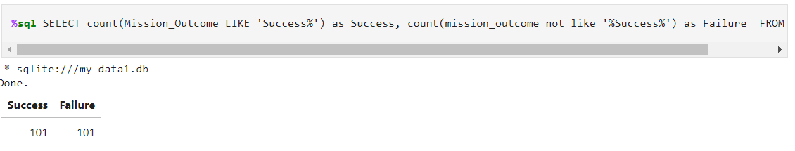
Total Number of Successful and Failure Mission Outcomes
Calculate the total number of successful and failure mission outcomes

Slide 32
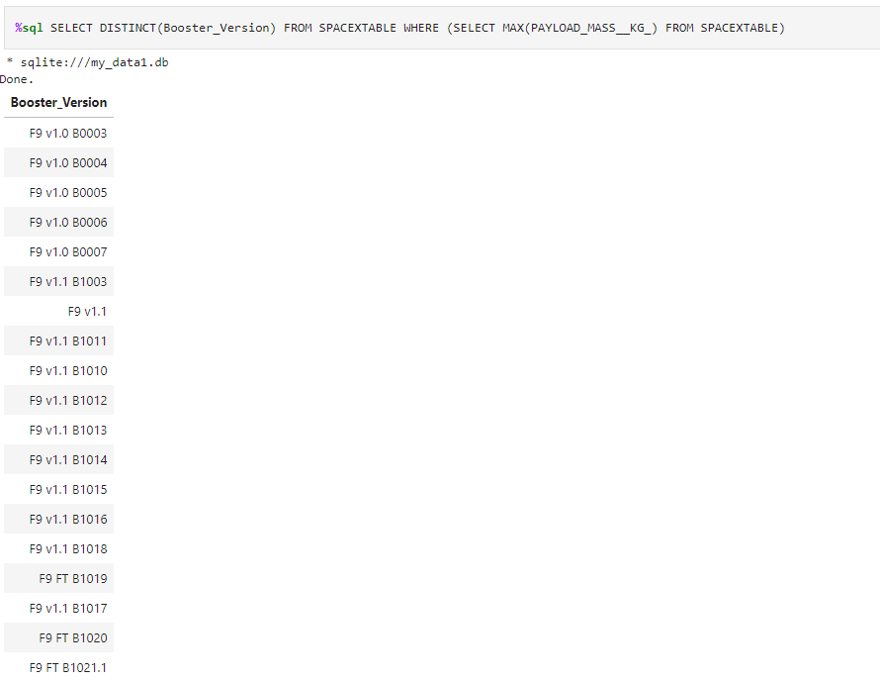
Boosters Carried Maximum Payload
List the names of the booster which have carried the maximum payload mass

Slide 33
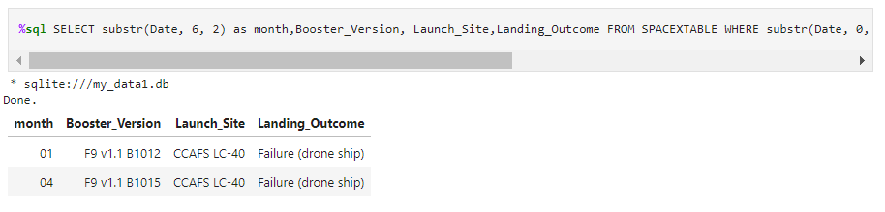
2015 Launch Records
List the failed landing_outcomes in drone ship, their booster versions, and launch site names for in year 2015

Slide 34
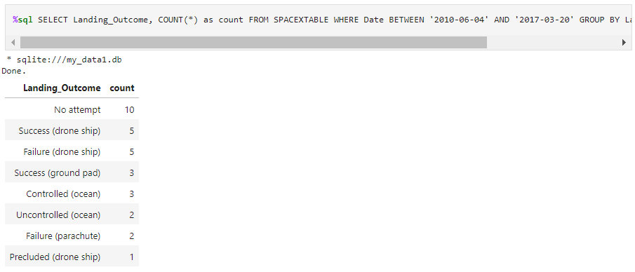
Rank Landing Outcomes Between 2010-06-04 and 2017-03-20
Rank the count of landing outcomes (such as Failure (drone ship) or Success (ground pad)) between the date 2010-06-04 and 2017-03-20, in descending order

Slide 35

Section 3

Slide 36
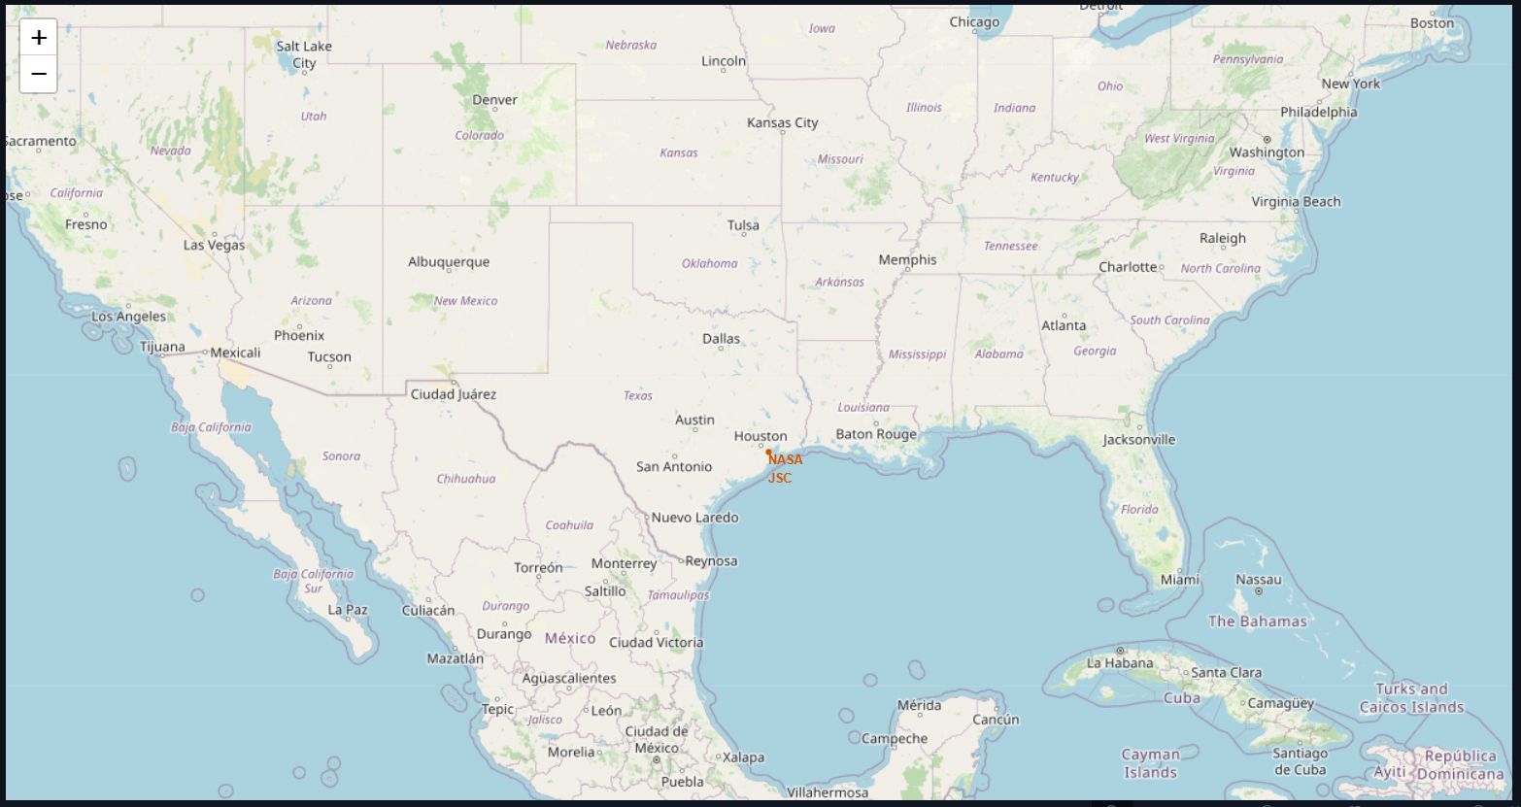
Start Location NASA at Houston, Texas
The location of NASA in Houston, Texas, is marked on the map.

Slide 37
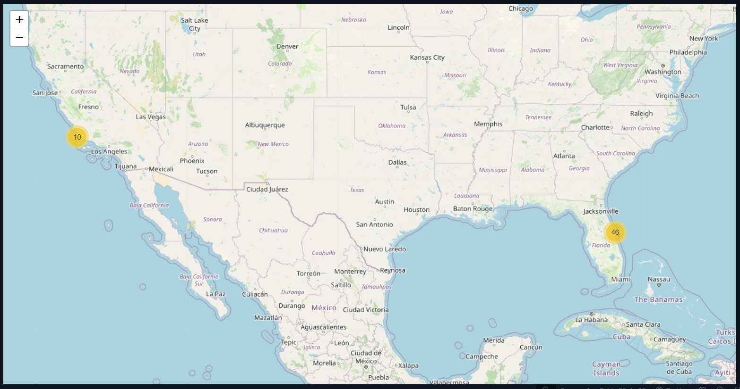
Success/Failed Launches of Each Site
The locations of the successful and failed launches for each site are marked.

Slide 38
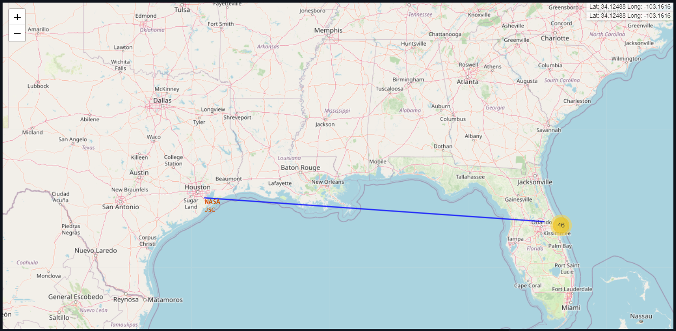
Distance Between the NASA and the Launch Sites

Slide 39

Section 4

Slide 40
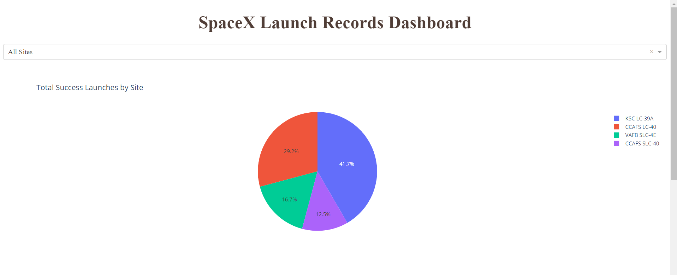
SpaceX Launch Records Dashboard - pie
A pie chart was created showing the total launches from each site.

Slide 41
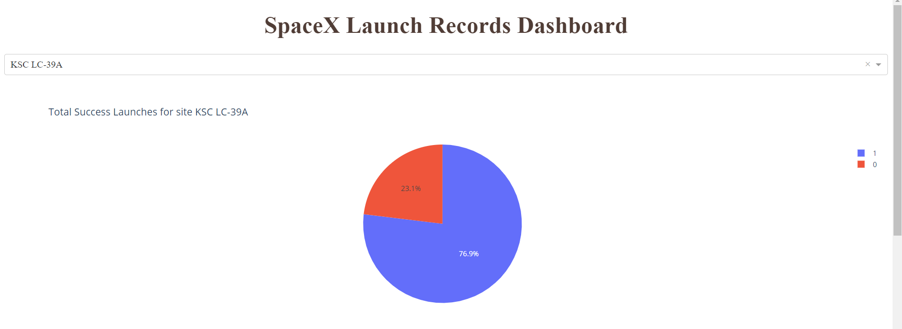
SpaceX Launch Records Dashboard - highest launch success ratio
A pie chart showing the highest success rate of launches.

Slide 42
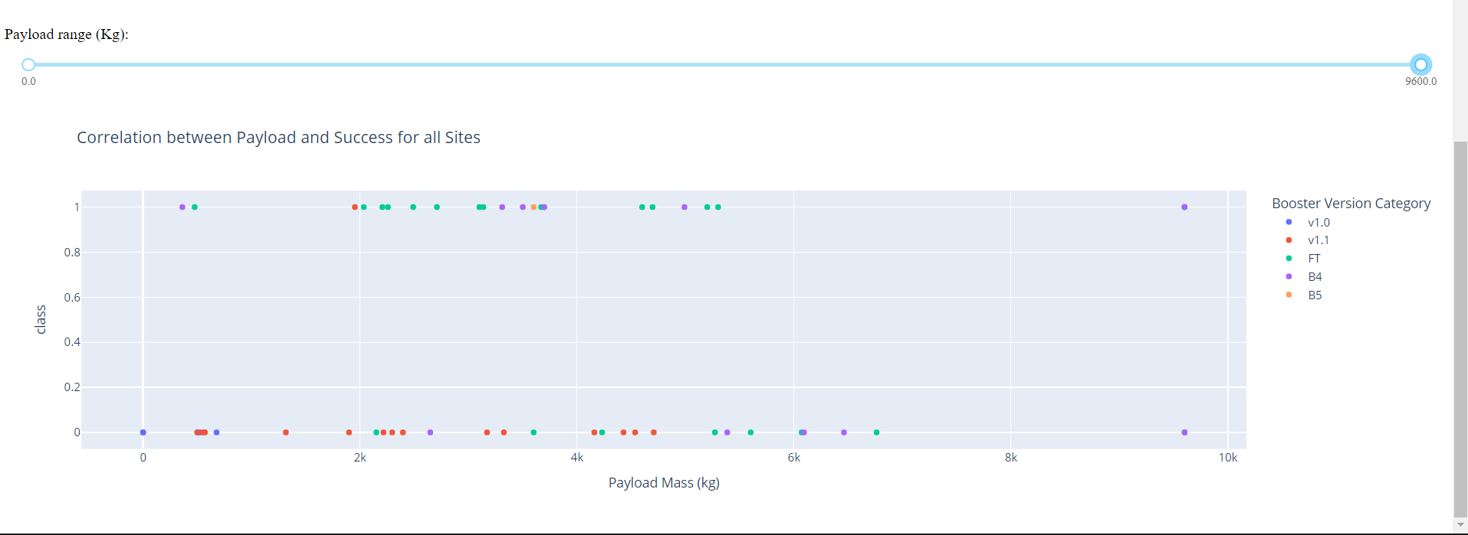
SpaceX Launch Records Dashboard – Payload vs Launch Outcome
The booster version with the widest range of masses is version B4, ranging from 362 kg to 9600 kg.

Slide 43

Section 5

Slide 44
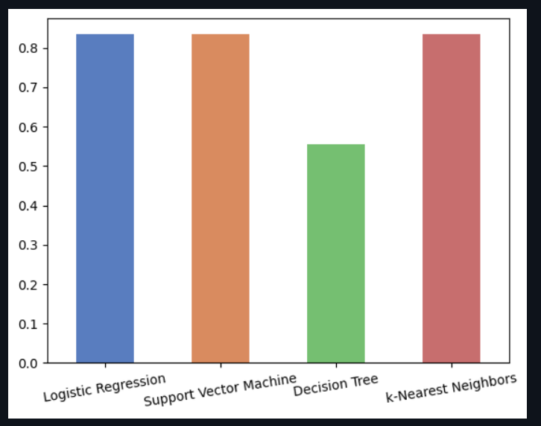
Classification Accuracy
The models who have more accuracy are
Logistic Regression
Support Vector Machine
K-Nearest Neighbors

Slide 45
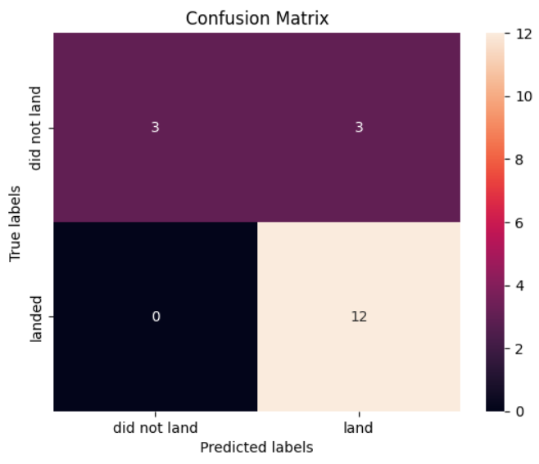
Confusion Matrix

Slide 46
Conclusions
Success in Predicting Landings:
The reuse of the Falcon 9 rocket's first stage has significantly reduced launch costs for SpaceX.
The predictive model developed has proven effective in forecasting the success of landings, with the Support Vector Machine (SVM) model achieving the highest accuracy.
Key Influencing Factors:
The analysis identified key factors influencing the success of landings, including payload mass, orbit type, and launch site location.
Data Collection and Wrangling:
Comprehensive data collection from SpaceX and IBM websites was crucial.
Data wrangling involved cleaning and transforming the data to ensure accuracy and usability.
Exploratory Data Analysis (EDA):
EDA using SQL, Pandas, and Matplotlib revealed important trends and correlations in the data, such as the success rate by year and payload mass distribution.
Interactive Visual Analytics:
Tools like Folium and Plotly Dash provided interactive visualizations, enhancing the understanding of spatial distributions and success factors.
Predictive Analysis:
Various classification models (Logistic Regression, SVM, Decision Tree, K-Nearest Neighbors) were used, with SVM showing the best performance.
The models provide valuable insights that can help improve future missions and strategies for SpaceX and other aerospace companies.

Slide 47


